Slide 1
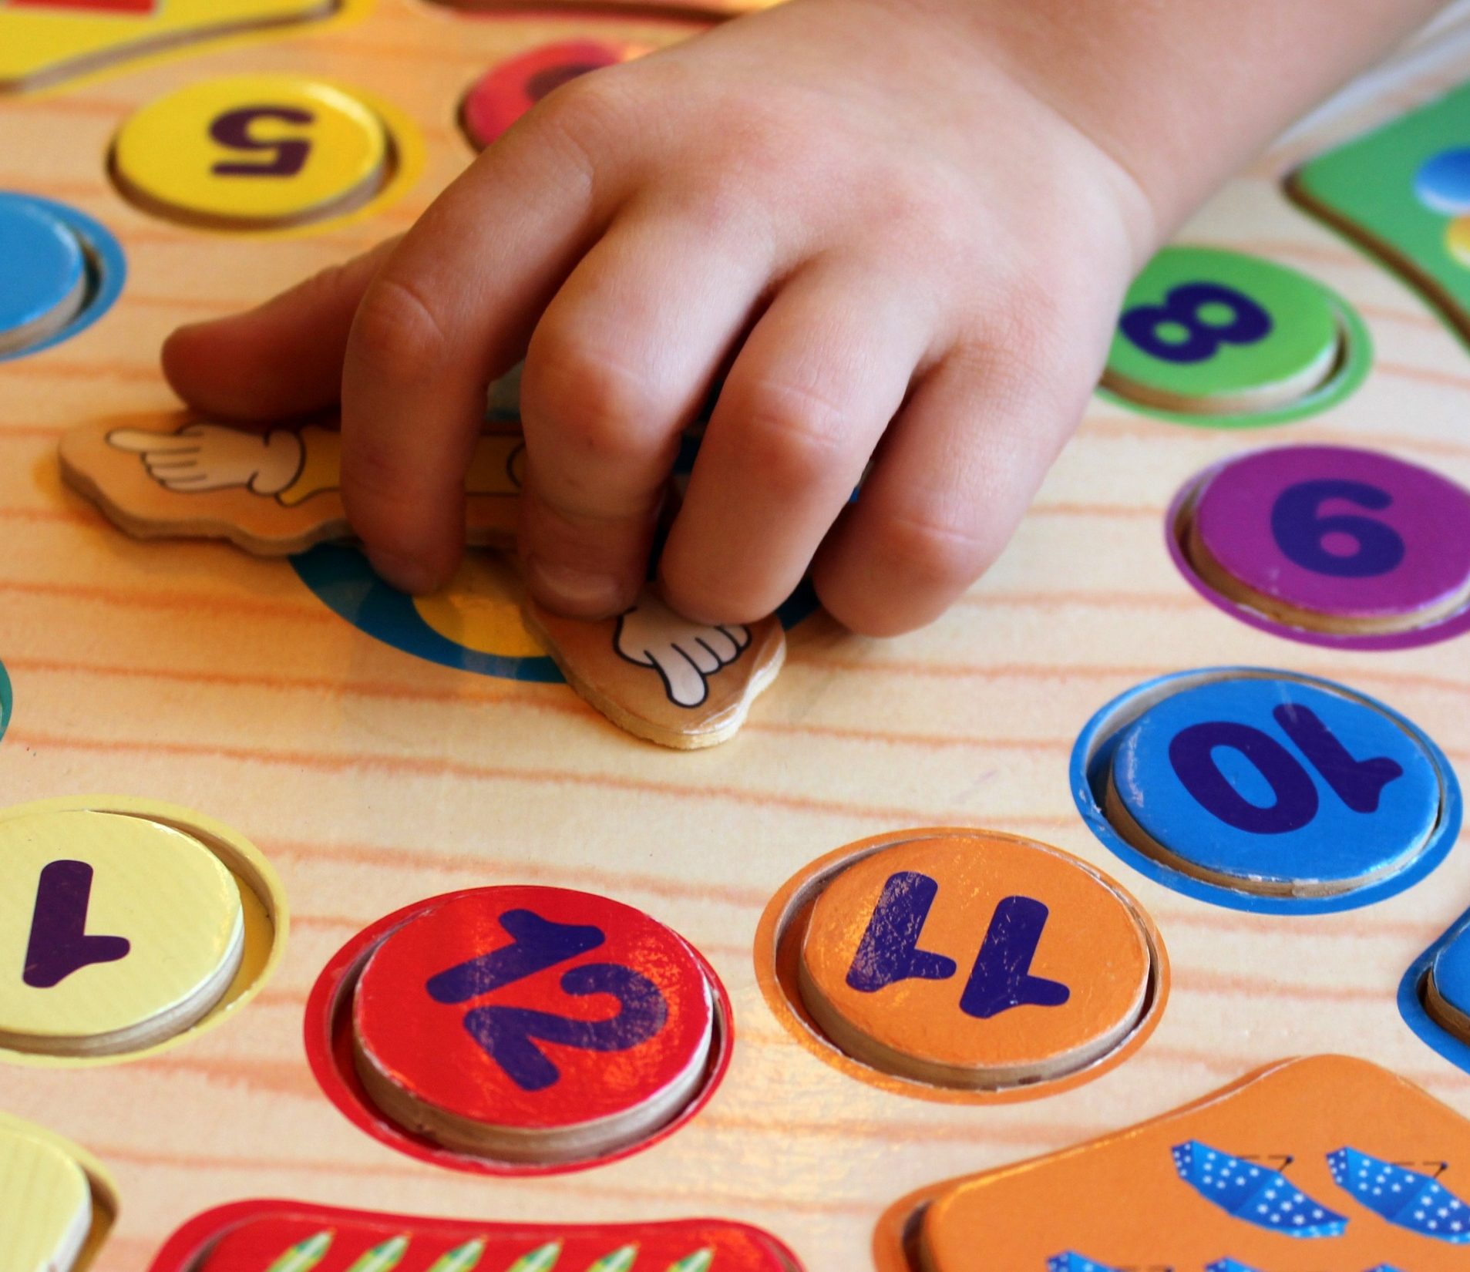
School If your child was born between 1st March 2018 and 28th February 2019, you can register them in January 2023 to start attending school in August 2023. The registration period for school places for term 2023/24 is open from Monday, 16th January to Friday, 20th January 2023. If you miss it, please contact your chosen primary before the end of February. Click this link to apply: https://www.aberdeenshire.gov.uk/schools/school-info/admissions/primary-school-registration/.
If you need an interpreter to assist with your child's application, contact eal.service@aberdeenshire.gov.uk

