Slide 1
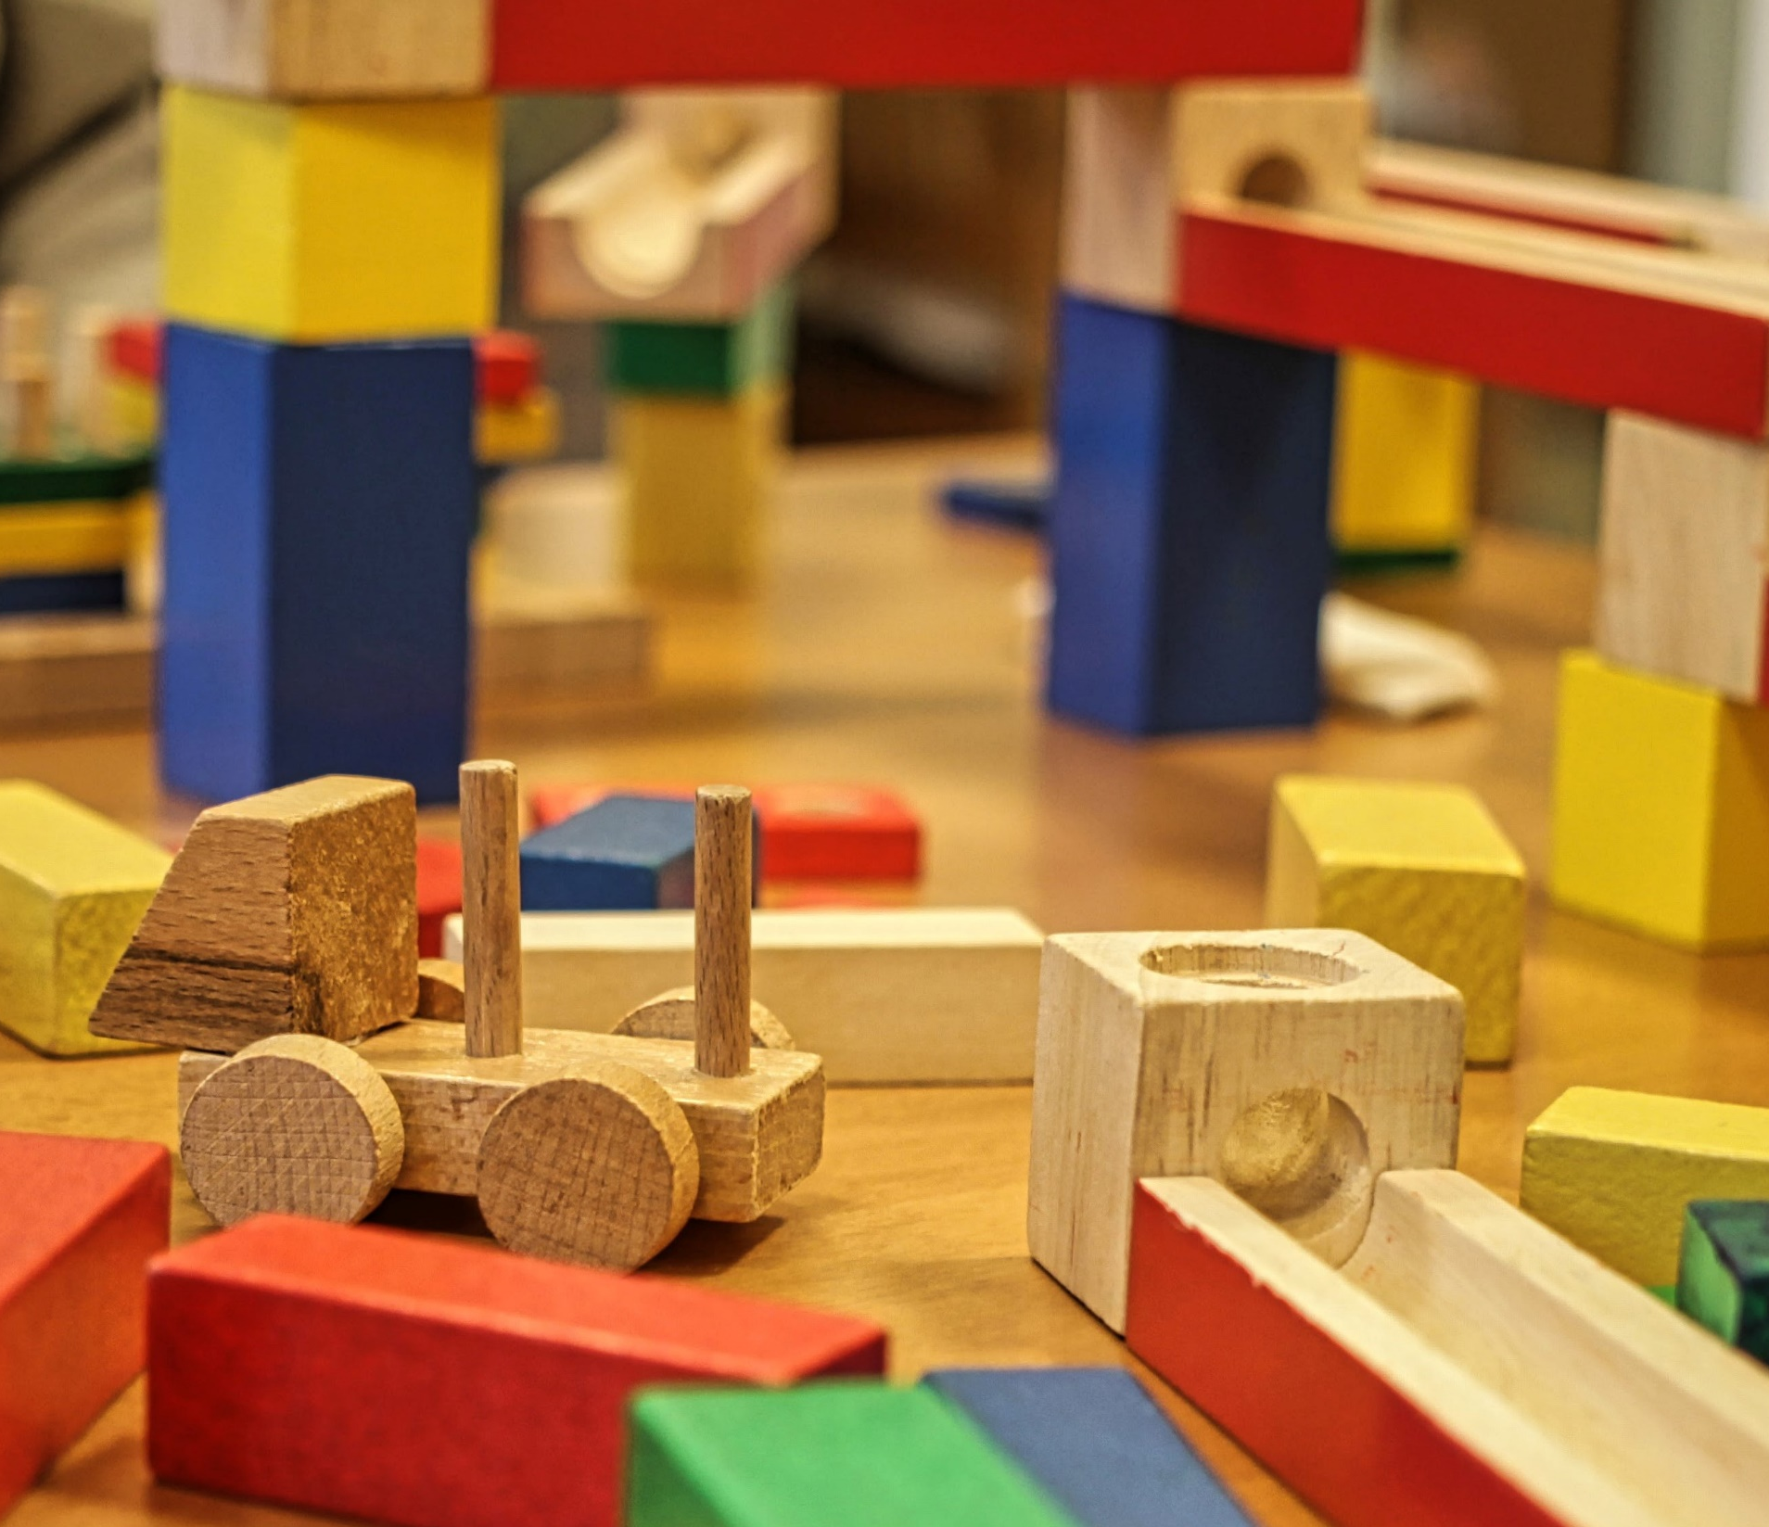
Nursery Children aged 3 or 4 years of age have a right to approximately 30 hours of free early learning (nursery) or childcare per week The application form for 2023/24 early years (nursery) places will be available from Monday 23rd January 2023 to Friday 3rd February 2023. To apply, click this link: https://www.aberdeenshire.gov.uk/social-care-and-health/childcare-and-early-learning/3-and-4-year-olds/ If you need help, contact your local nursery or email earlyyears@aberdeenshire.gov.uk
Children born between: | Can start nursery from:
1st March 2019 – 21st August 2020 | 22nd of August 2023
22nd August 2020 – 29th October 2020 | 30th of October 2023
30th October 2020 – 7th January 2021 | 8th of January 2024
8th January 2021 – 14th April 2021 | 15th of April 2024

